Slide 1

Preston Primary School
Welcome
Information for new parents

Slide 2
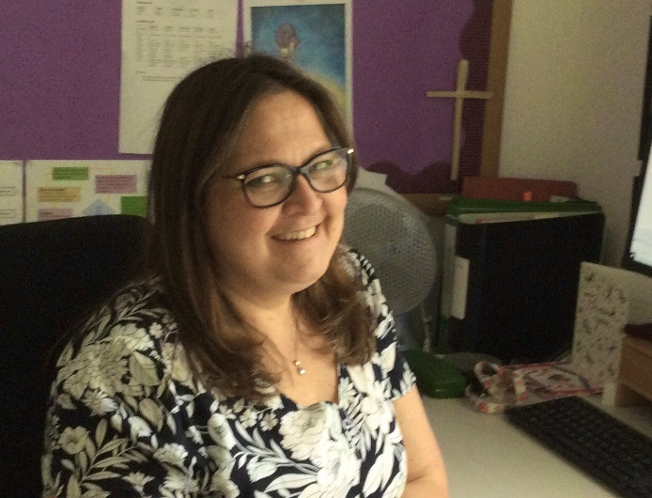
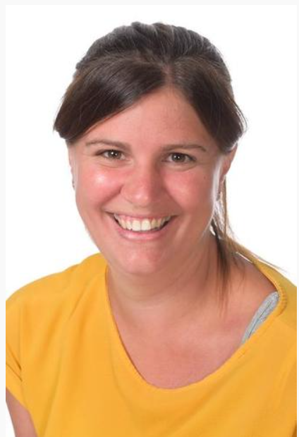
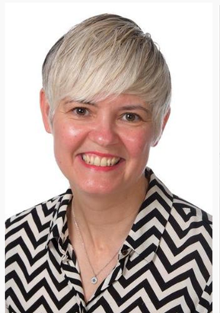
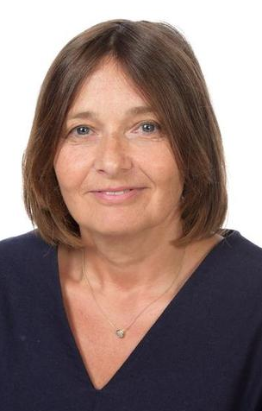
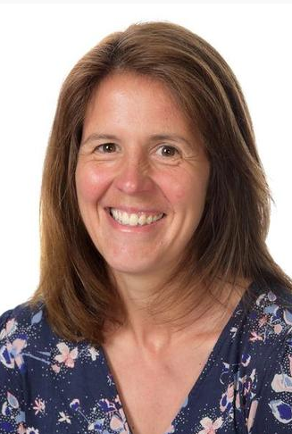
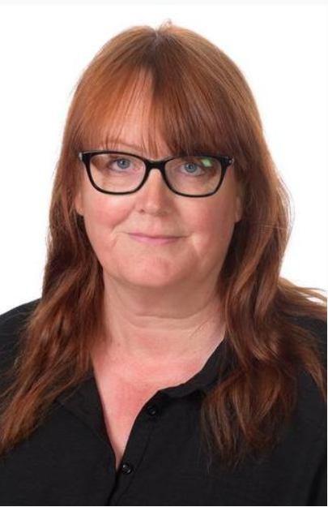
People you’ll see around the school to begin with
Mrs Luitingh
Mrs Gittings
Mrs Bithrey
Mrs Groves
Mrs Trott
Mrs Dyer

Slide 3
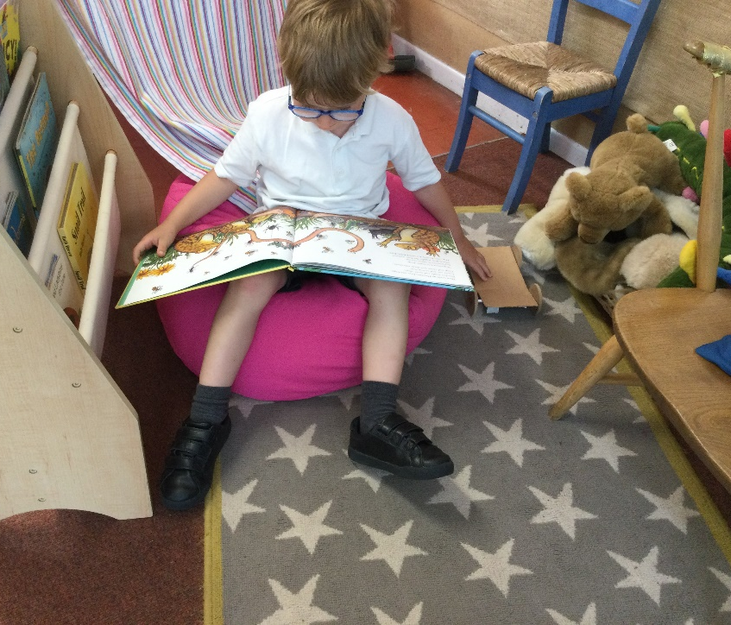
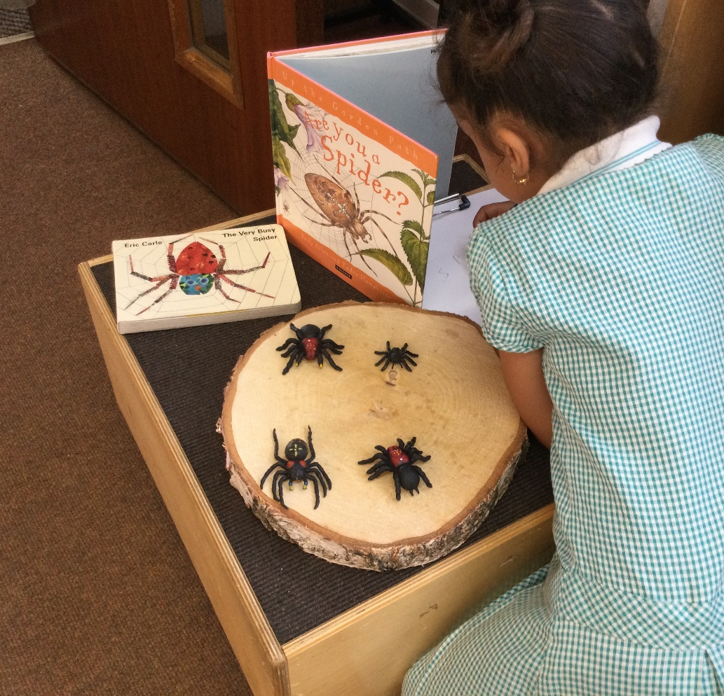
EYFS – Chestnut Class
Indoor Provision
Chestnut class will come in and self register and answer their question of the day.
The class is set up so that your children can navigate their way around independently.
Our Early Years provision is based on your children’s interests and in Reception, there is a balanced mix of adult-led and child initiated learning.
Independent exploration is an important part of learning and gradually, children will build up the resilience to work for sustained periods of time.

Slide 4

EYFS
Outdoor Provision – Our fabulous natural learning environment

Slide 5
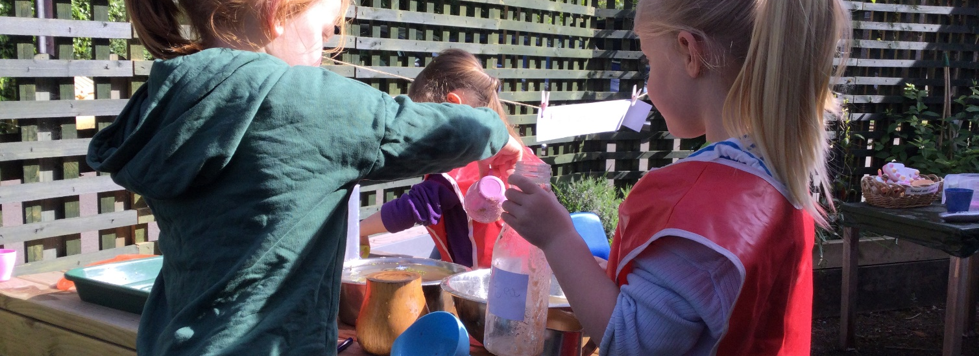
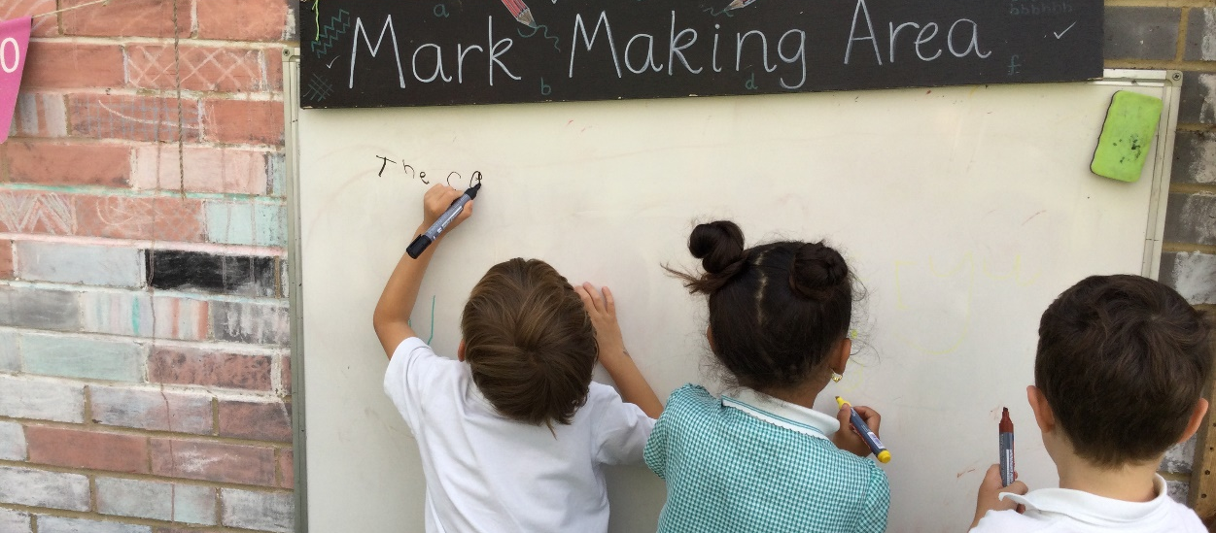
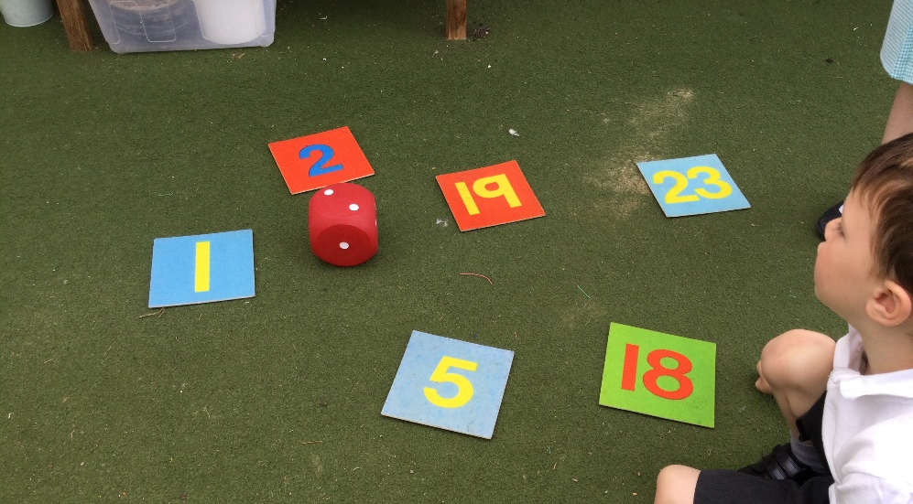
EYFS – Chestnut Class outdoor Provision
We have an extensive outdoor environment to enrich your child’s learning here at Preston
Chestnut have their own designated outside area in which they can use as part of their learning, this includes opportunities for investigative learning, as well as developing gross motor skills such as climbing. We use this in all weathers, as it is an undercover area.
We also make good use of the wider school environment such as the pond, the outdoor classroom and the playground to ride our balance bikes and scooters.

Slide 6
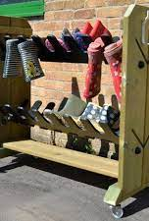
Nature School
The aim of these sessions is for children to develop resilience, confidence and independence in a natural and creative environment.
Children will need to keep in school: named wellies and waterproof outerwear.
These sessions will be tailored to the children's interests and activities will therefore be based on what they are inspired by.
Notes:
We aim to deliver this throughout the year on average twice a week. Keep an eye on the website to see all the exciting things we get up to.
We want to provide a nature school that goes across the 3 year groups which has normally only been offered to Reception children. This gives all children to learn through a hands on approach and the children will continue to use their skills that they are taught within the class to outside.

Slide 7
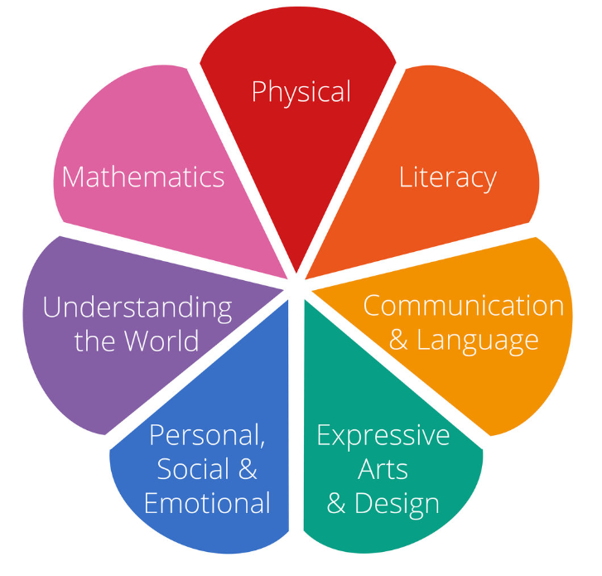
EYFS Curriculum
There are 7 main areas of learning in Reception. Children are working towards their early learning goals and initially your child will mostly be taught through adult-led activates and child initiative learning.
The areas of learning are:
communication and language
physical development
personal, social and emotional development
literacy
mathematics
understanding the world
expressive arts and design

Slide 8
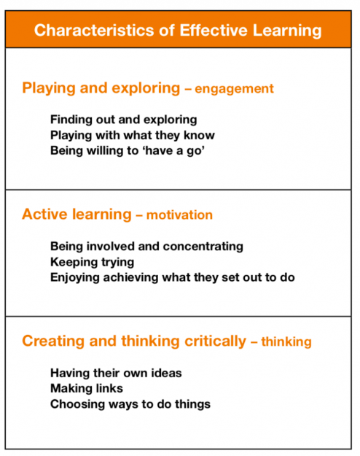
How will my child learn?
Characteristics of Effective Learning

Slide 9
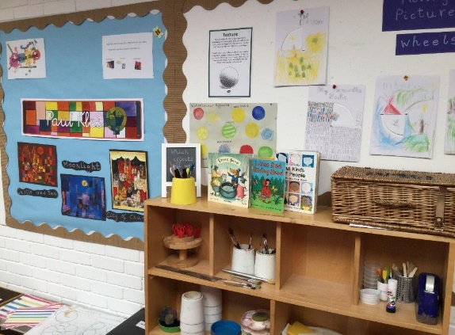
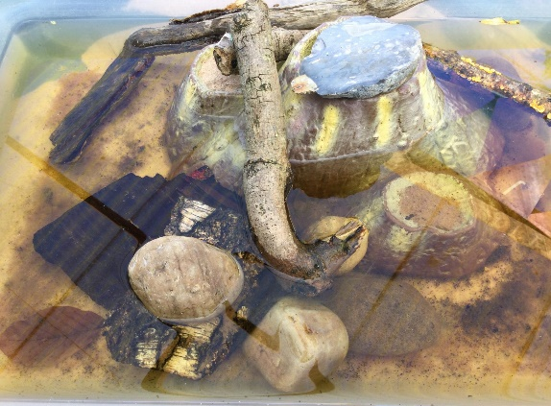
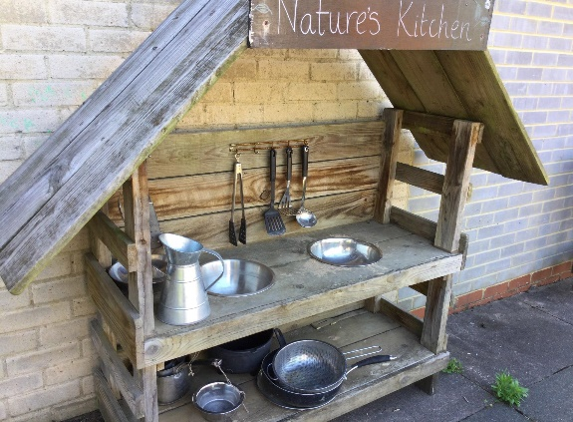
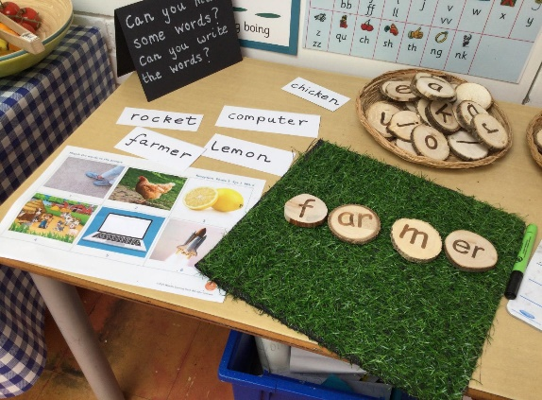
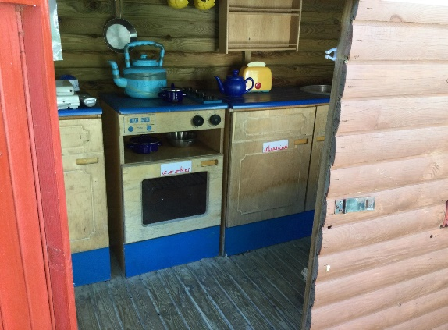
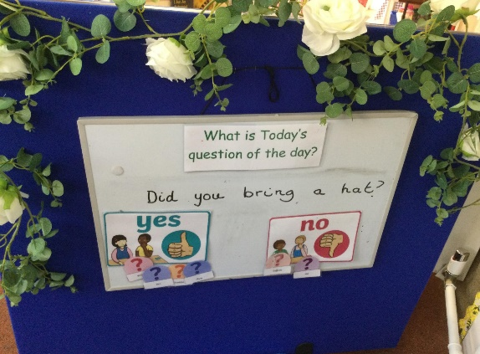
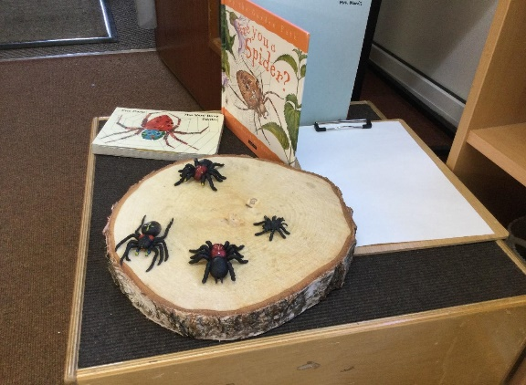
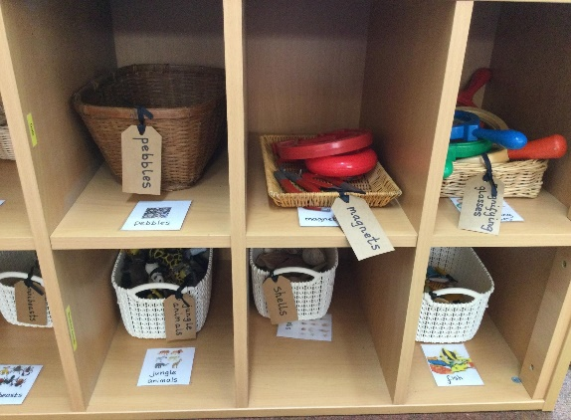
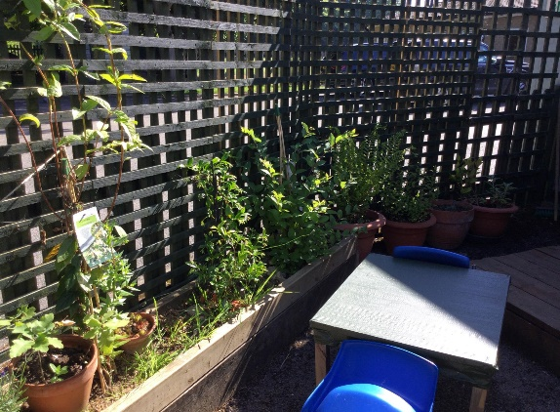
A day in the life of Chestnut Class

Slide 10
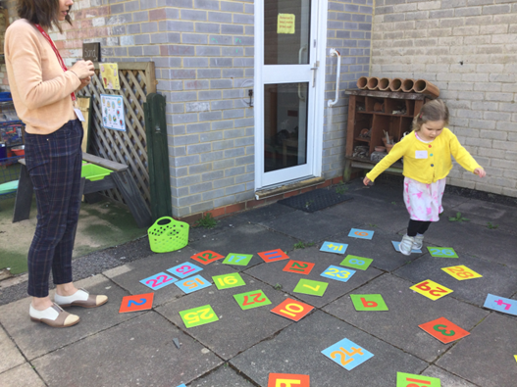
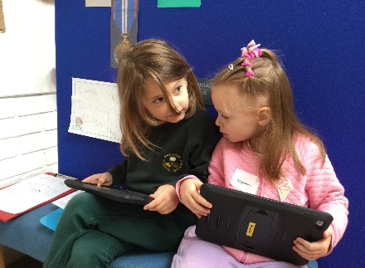
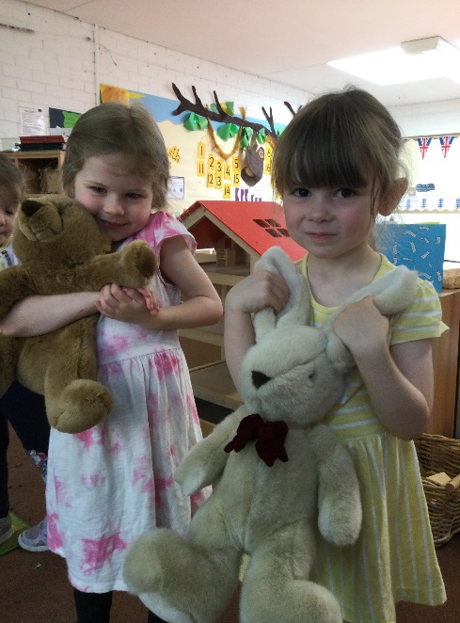
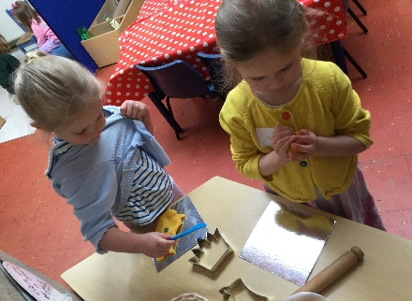
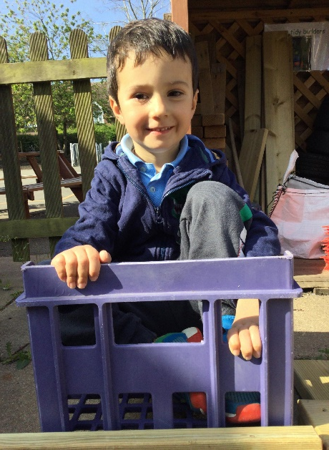
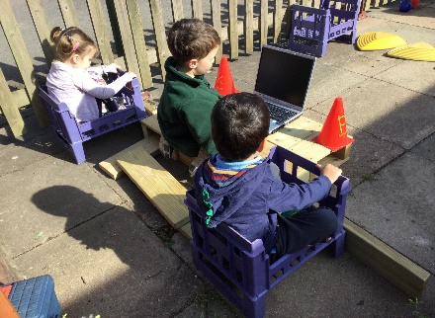
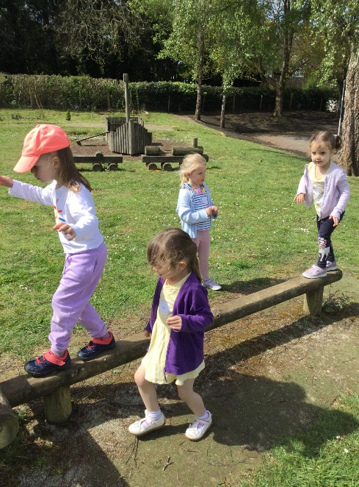
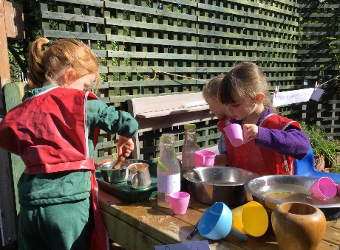
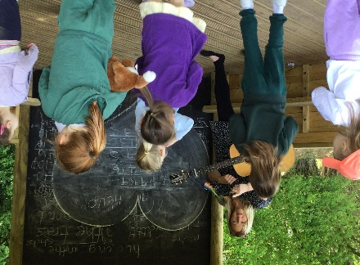
A day in the life of Chestnut Class continued…

Slide 11
Infants set up
The 2 classes will be taught by a team of adults whilst making use of their individual classes.
PLEASE NOTE that this is the average day and this may change based on the children’s needs on the day, as well as wider school events for example assembly. However, the teachers will plan each week to ensure a fair distribution of teaching staff. Coverage will be evaluated on a weekly basis.
 | Chestnut Class | Birch Class
8:45-9:15 | Reception and Year 1 (Only for the first half term) (T) Registration and early morning work | Year 2 Early morning Work
9:15-9:30 | Phonics in ability year groups led by 3 trained adults, the team will rotate.
9:30-10:00 | CIL for Reception | Year 1 & 2 (T) English and CIL spot following English learning for Year 1. (English and Maths will rotate)
10-10:30 | Reception English (T) Followed by CIL
10:30-10:45 | Playtime
10:45-11:00 | Reception Maths (T) | Y1 & 2 Whole Class Reading/Book Talk
11:00-12 | Reception CIL | Y1 & 2 (T) Maths and CIL spot following Maths learning for Year 1. (English and Maths will rotate)
12-1 | Lunchtime
1-3 | Topic Learning Y1 & 2 (Subjects to include: Science, RE, PE, Art, DT, Computing, Music, Geography and History) Activities led by an adult EAD, UW, PD, PSED. Child initiated activities supported by adults.

Slide 12

Reading and Phonics
We use Little Wandle Phonic Scheme to support early reading. You will be invited to a more detailed workshop about this in early September.
In the meantime, to help boost early reading and literacy skills, we encourage regular reading with your child and lots of discussion around the book as this is vital in the early stages of reading.

Slide 13

How can I find out about how my child is doing?
At Preston, we use Tapestry as a platform to share information regarding your child's progress in Reception. It is a secure online learning journal that enables parents and staff to share videos, photos and diary entries to celebrate a child's learning and development.
Parents are encouraged to share any information about your child’s development and progress on a regular basis. It is always exciting to see what the children are up to during the weekend, holidays and special family celebrations.
More details on how to use the APP is on our website.

Slide 14

Communication
Communication is so important. It plays a huge role in ensuring that you are regularly sharing information with us to best support your child. We do this by….
Termly parent consultation meetings
School website for weekly updates
Tapestry (reception children)
Google Classroom (y1 and 2 children)
Newsletters
Email

Slide 15
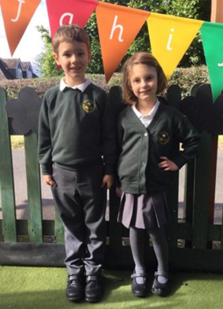
What your child needs in school
Named water bottle with fresh water in it every morning and this will come home each day to be washed
Reading book bag with their reading book every day and reading record.
Named coat, wellies, and a spare set of clothes
On PE days children need to come to school ready in their PE kits, days to be confirmed.

Slide 16
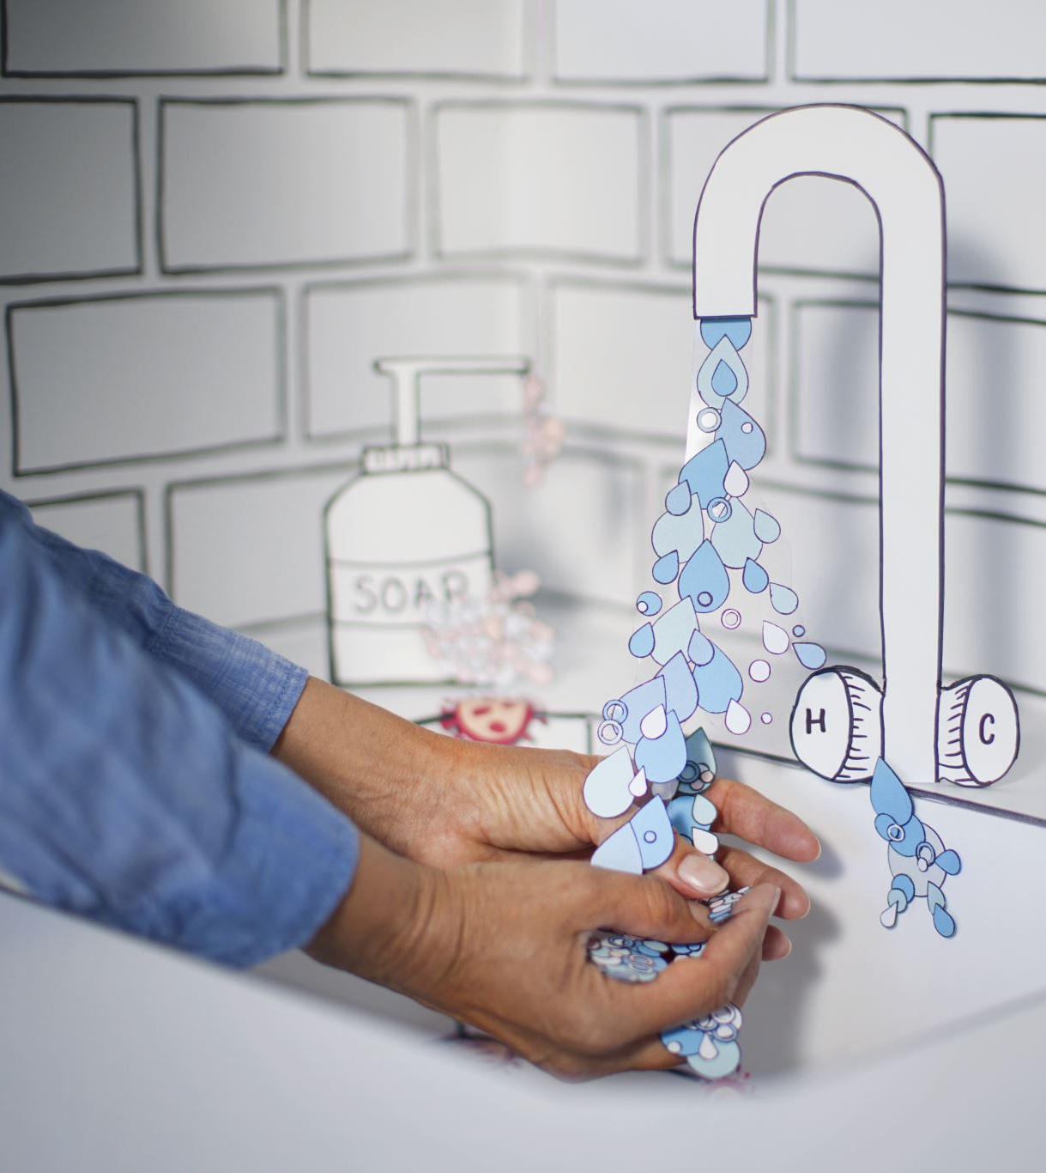
What your child should be able to do before starting school
Use the toilet independently and wash their hands.
Recognise their name and their belongings.
Use a knife and fork to cut and eat their lunch.
Put on and fasten their coats.

Slide 17
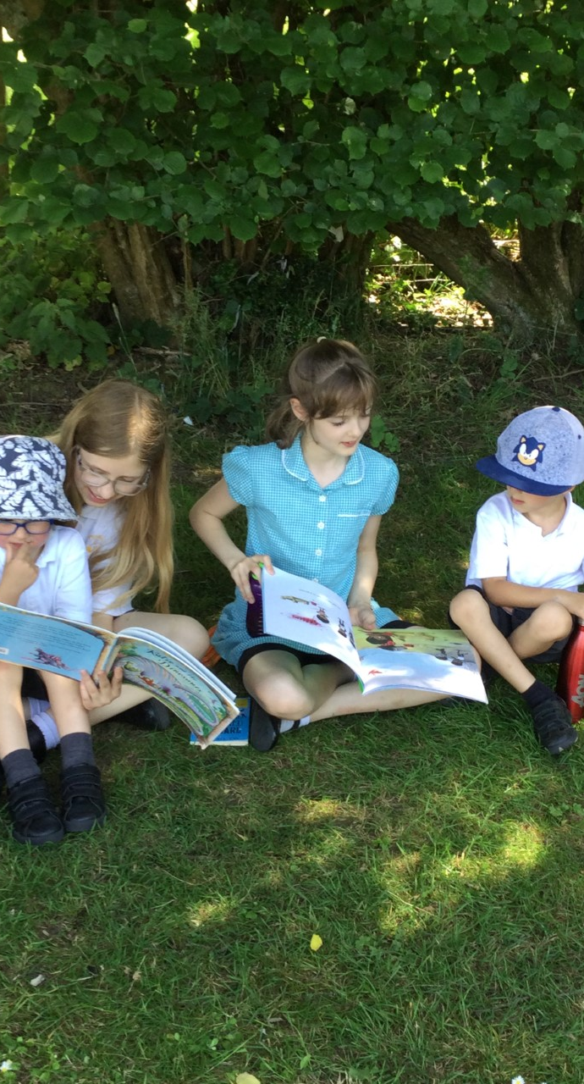
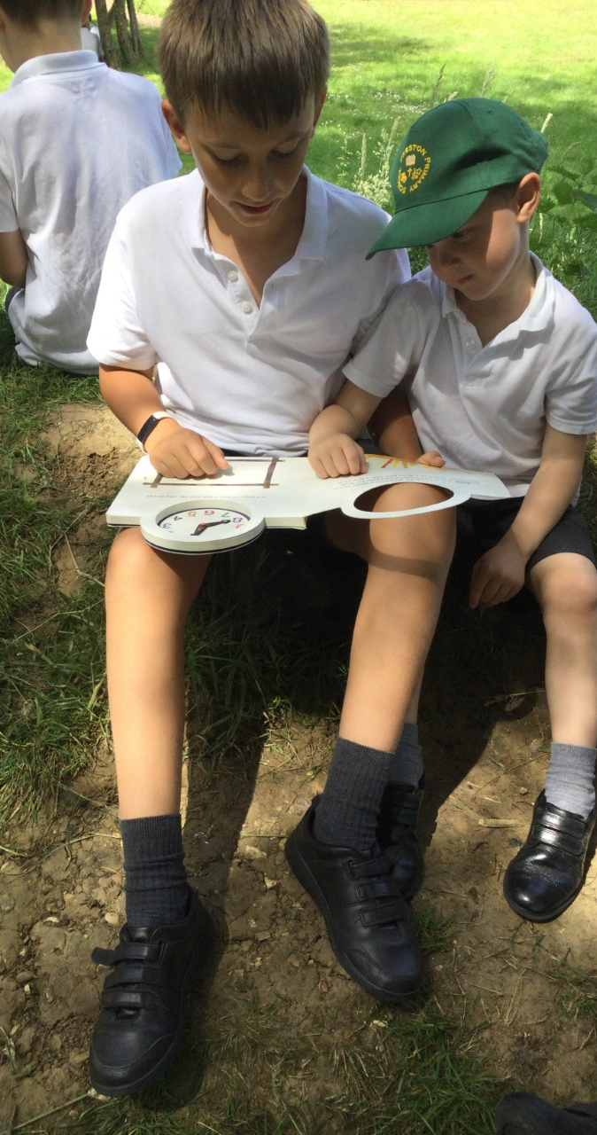
Buddies
Your child will be supported by a year 6 buddy from September. They will be available through playtime and lunchtime to help your child as they settle into school life.

Slide 18

Any Questions?
We are really excited to be welcoming you and your children to Preston and we cannot wait to work in partnership with you.

