Slide 1
UK Parliament and the Preston Pupil Parliament

Slide 2
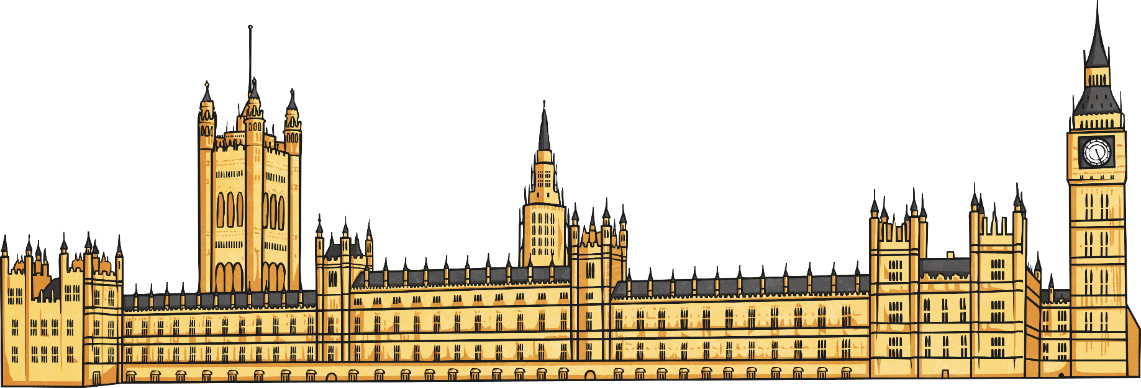
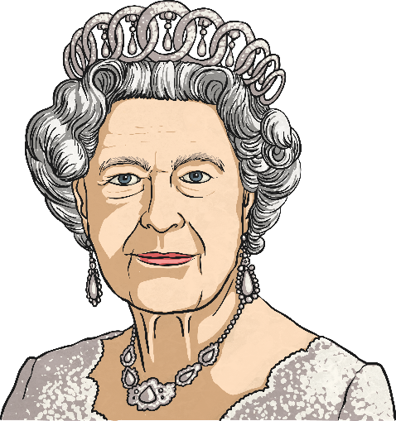
Parliament
The UK Parliament is the place where Members of Parliament (MPs) meet to make decisions and pass laws. Parliament makes sure that the government are running the country properly.
The UK Parliament is made up of the Queen, the House of Lords and the House of Commons.

Slide 3
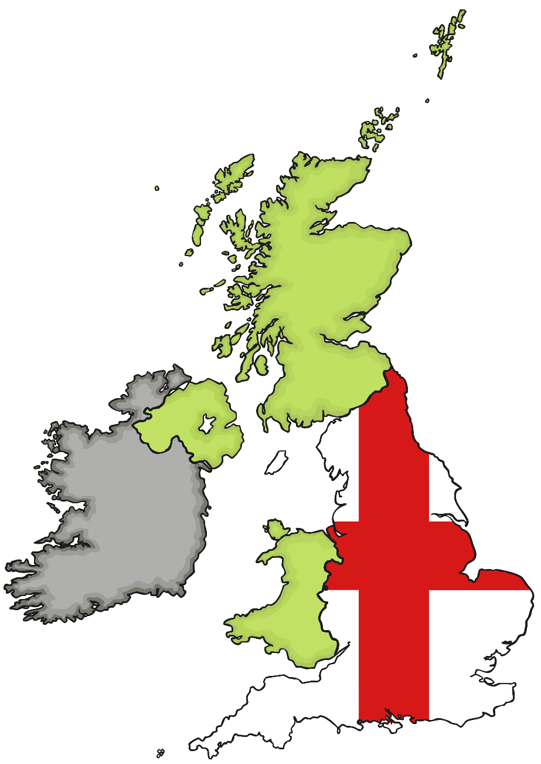
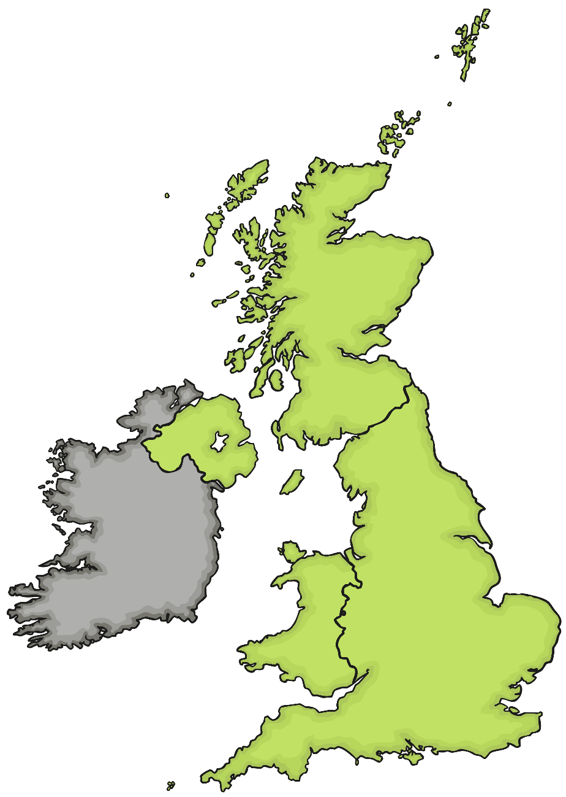
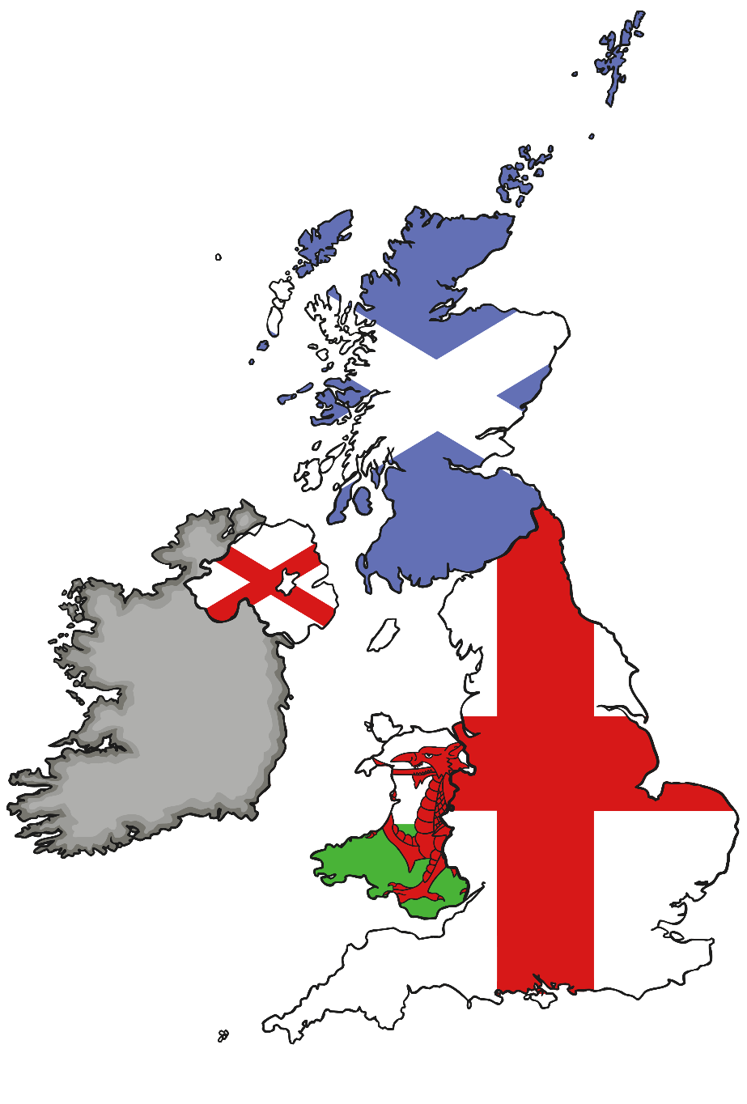
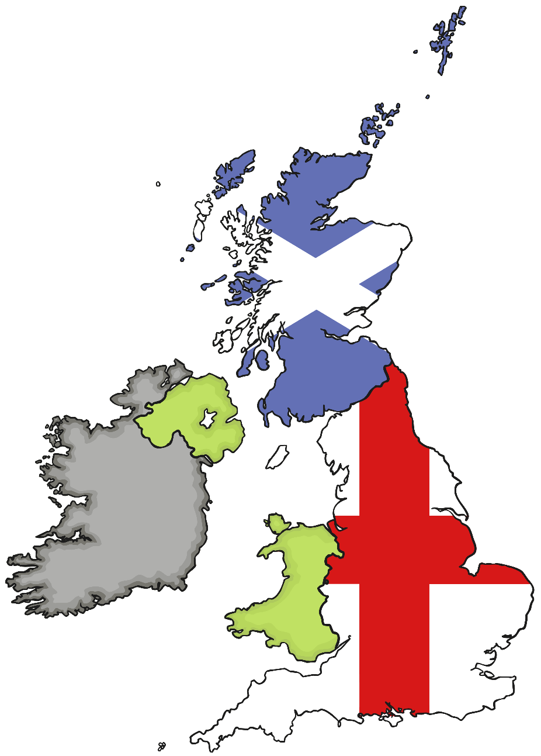
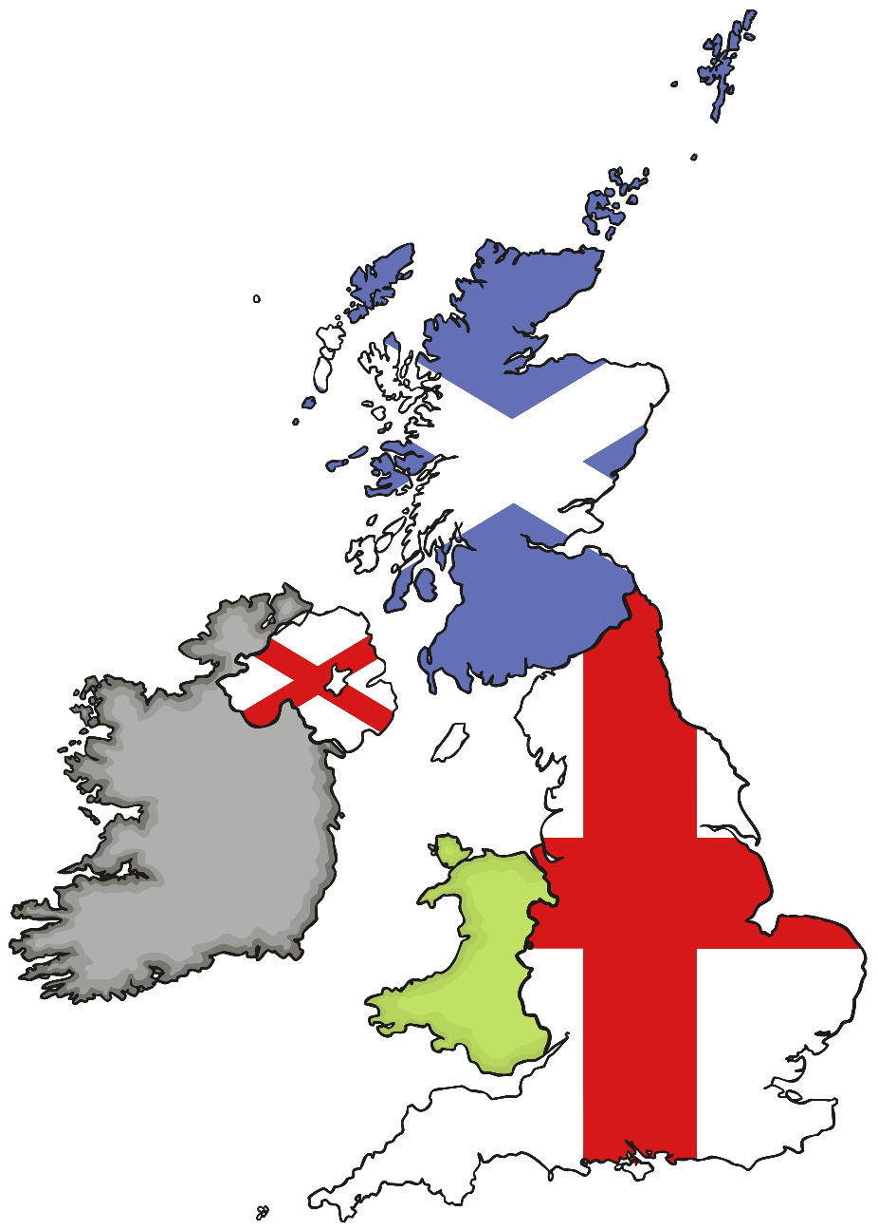
The UK Parliament
England is the only country in the UK which does not have its own Parliament.
Scotland has the Scottish Parliament,
Northern Ireland has the Northern Ireland Assembly
and Wales has the Welsh Assembly.
The UK Parliament keeps control of foreign affairs and defence though.

Slide 4
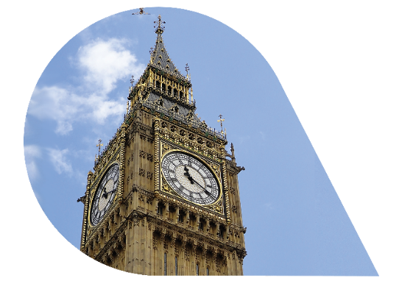
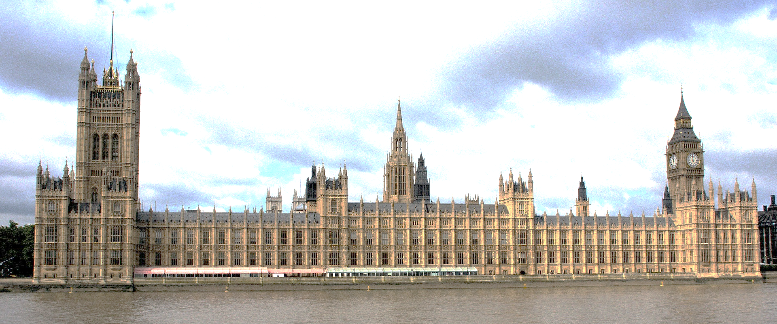
Houses of Parliament
The clock tower is one of London’s most famous landmarks and is nicknamed Big Ben.
The House of Lords and the House of Commons meet in the Houses of Parliament in Westminster, London.

Slide 5
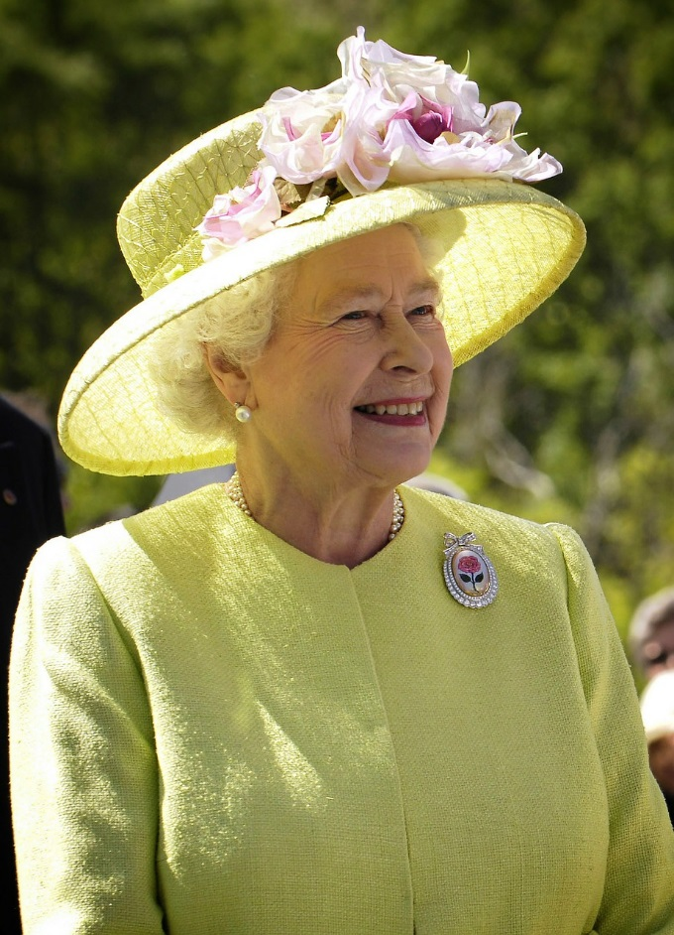
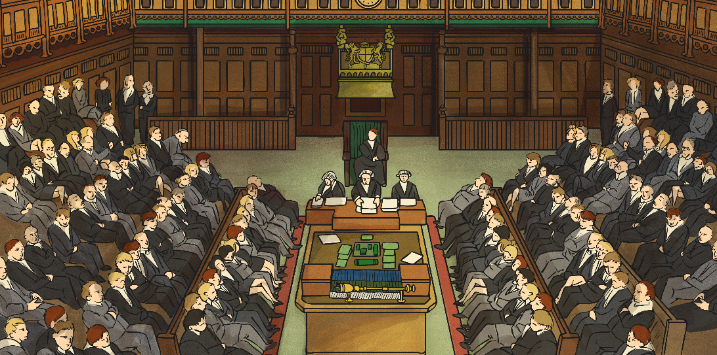
Queen Elizabeth II
The Queen is the head of state.
The Queen opens parliament each year, but because Britain has a constitutional monarchy it means the Queen does not have any political power.

Slide 6
House of Lords
The Peers meet in the southern part of the Palace of Westminster.
The House of Lords is where peers meet. They check that new laws are fair.
Each member has either inherited a family title or has been given a title to recognise their good work in a certain area.

Slide 7
House of Commons
The Members meet in the northern part of the Palace of Westminster.
The House of Commons is where the Members of Parliament (MPs) meet.
Each MP has been elected by the people in their constituency (local area).
Most MPs belongs to a political party, although a very small number are independent.

Slide 8
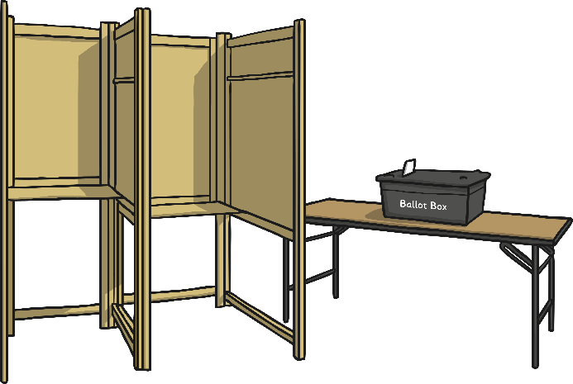
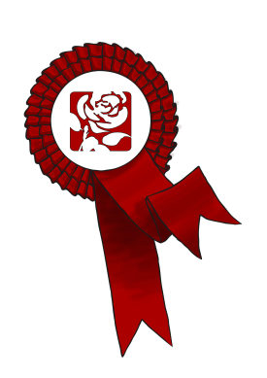


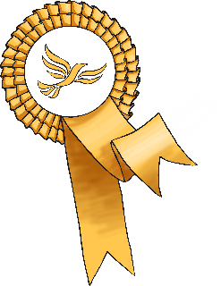




Elections
At least every 5 years, a general election is called by the Prime Minister.
In the UK, each adult can vote for a politician in their constituency (local area) to represent them in the House of Commons.
The majority of politicians belong to a political party.
The political party which wins the majority of the seats forms the government. The leader of that political party becomes the Prime Minister.

Slide 9
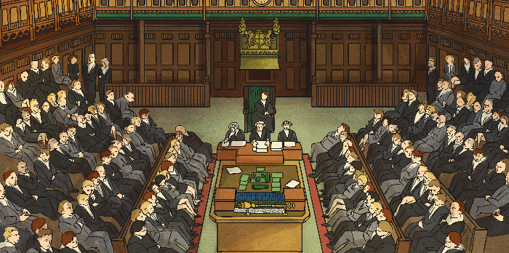


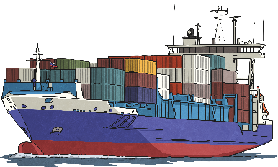
The Government
The Government is led by the Prime Minister.
The Prime Minister belongs to the political party with the majority (the most) of the seats.
The Prime Minister chooses their team of ministers from their party to lead the work on important areas of the country's business, such as trade and education.
These ministers are called the Cabinet and help the Prime Minister to run the country.

Slide 10
Preston Pupil Parliament
At Preston we are now going to have our very own Pupil Parliament!
The parliament will help to make decisions about how to improve the school.
Monarch (Mr Hart)
Prime Minister (Mrs Luitingh)
House of Lords (The governors)
Speaker (Mrs Dye)
Members of Parliament (MPs – Year 6, joined by representatives from each class)
Environment Committee (Eco Warriors, put actions in place to protect our environment))
Learning Committee (focusing on curriculum)
Community Committee (focusing on values, rights, support for behaviour for learning)
Wellbeing Committee (Supports our wellbeing)

Slide 11
What will happen now?
Each class will elect 4 Members of Parliament (MPs).
Each one will join one of the MP committees.
Environment Committee MP –they are your Eco Warriors and will put actions in place to help save the environment.
Community MP – they will complete work linked to our school values and our rights, and help support behaviour in our school so that everyone is ready to learn.
Wellbeing MP – they will be thinking about the wellbeing of our school community and how we can support them
Learning MP – they will be working on our curriculum – all the things that we learn in school and help us have everything we need to be learning heroes!

Slide 12
We need you!
We need some amazing people to be part of our Pupil Parliament! You will need to be:
Enthusiastic about making things even better at our school
Willing to try new things
A brilliant role model for your class
Great at talking to others – both in your own class and in other year groups too
Would you like to be elected by your class? Think carefully about which committee would be most suitable for you.
Talk to your teacher and they will explain how you might be chosen to be one of your class MPs this year!

