Slide 1
Just Talk
Wellbeing committee

Slide 2
Just talk
COMPETITION

Slide 3
The competition is based on
The 5 Steps to Wellbeing

Slide 4


TAKE NOTICE
Create a picture/ painting, comic strip,poem or piece of music, that expresses how covid has made you feel & tell us why you think your creation expresses how you feel in no more than 50 words

Slide 5

learn
Write a short essay or poem ( no more than 250 words ) about how different our post covid 19 lives might currently look if the internet had never been invented.

Slide 6
BE ACTIVE GIVE
Design a fun 5 minute game that helps you to be active, and can be played whilst socially distanced.
Nominate someone you know ( a friend, family member or teacher ) who has done something kind for others during covid. Tell us in no more than 50 words. Why do you think they deserve to win our first ever ‘kindness’ award.

Slide 7
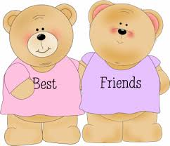
CONNECT
Create a catchy slogan or song about the importance of looking out for your friends

Slide 8
Remember…
DEADLINE:
26 November
HOMEWORK!!!

