Slide 1
Letters and Sounds
Phase 3

Slide 2


Slide 3
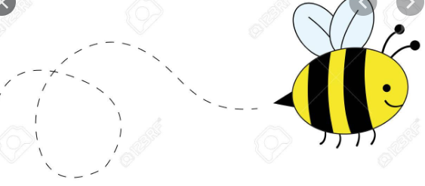
Buzz the Bee!

Slide 4


Slide 5
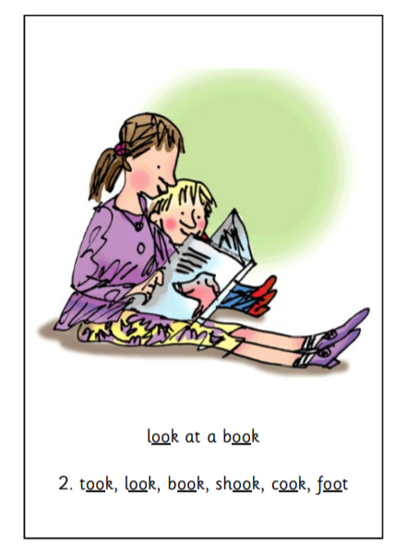

Slide 6
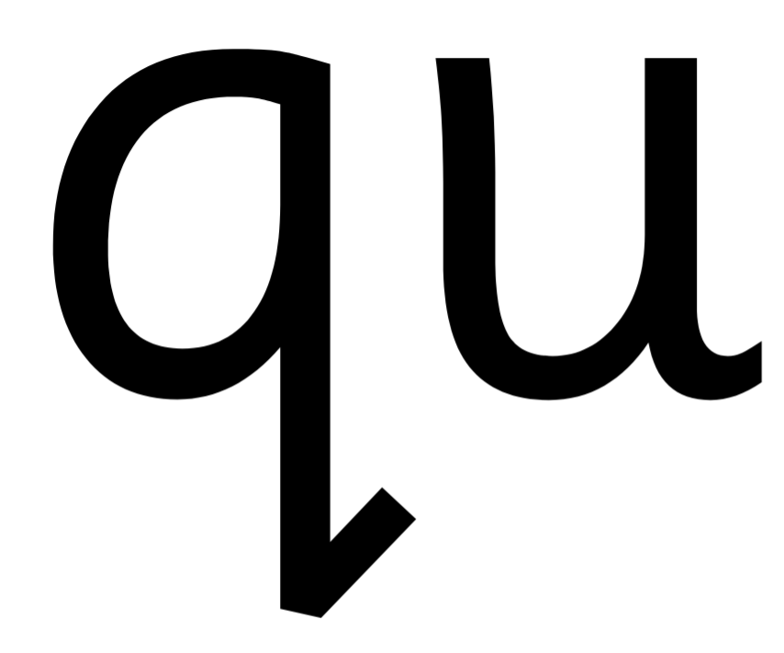

Slide 7
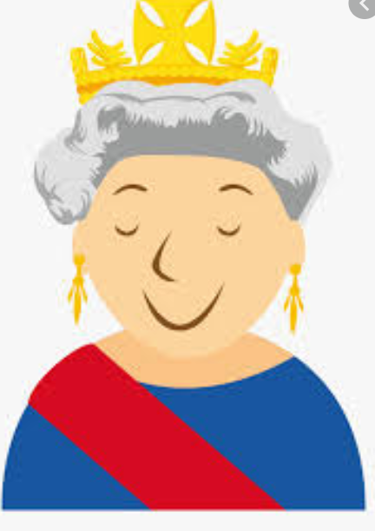
The Queen is quiet.

Slide 8


Slide 9
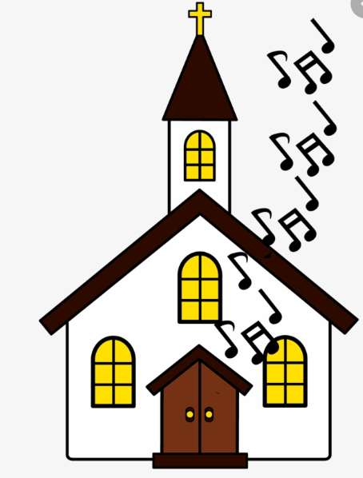
The cheerful Church!

Slide 10


Slide 11
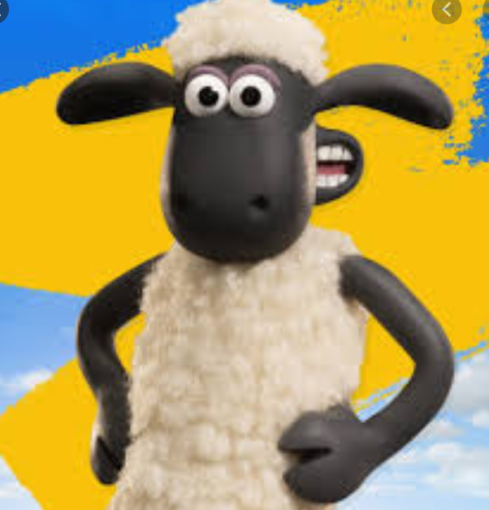

Slide 12


Slide 13

Thin thing!

Slide 14


Slide 15
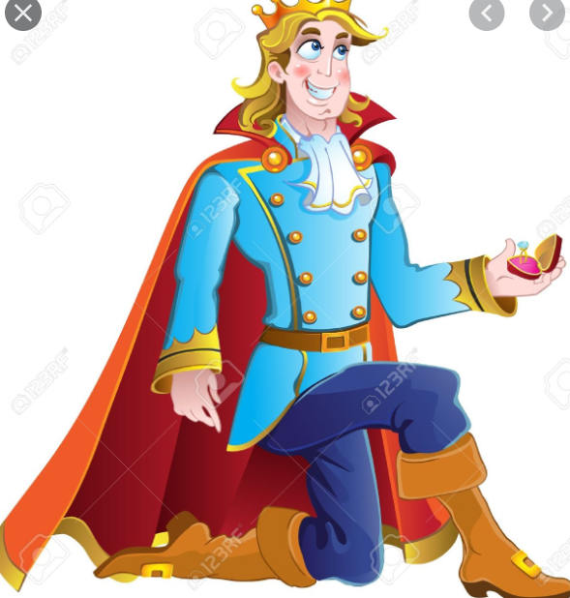
The King with a ring!

Slide 16
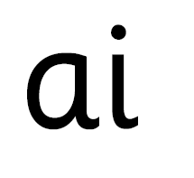

Slide 17
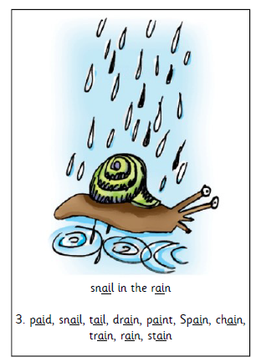

Slide 18


Slide 19
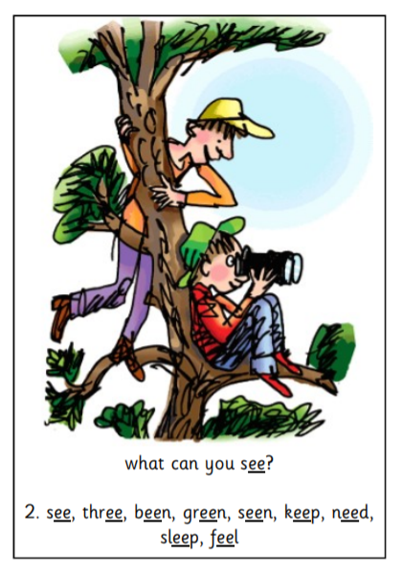

Slide 20


Slide 21
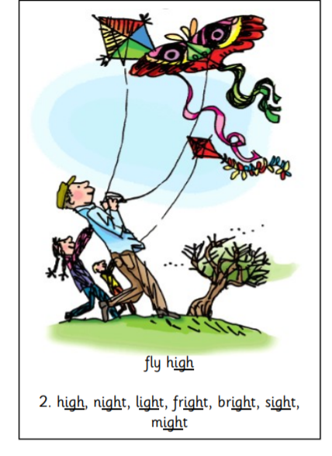

Slide 22
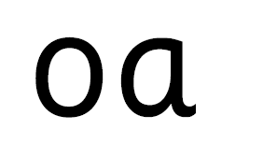

Slide 23
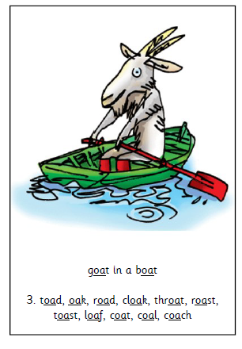

Slide 24


Slide 25
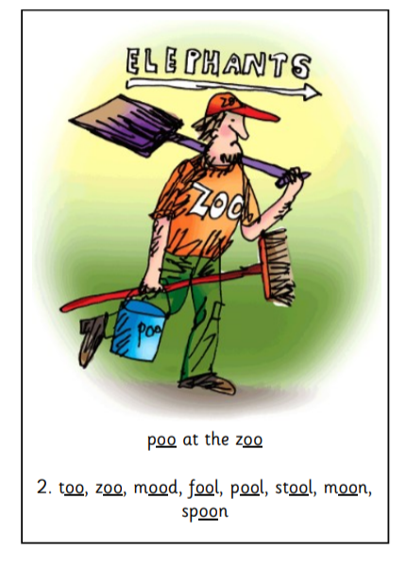

Slide 26


Slide 27
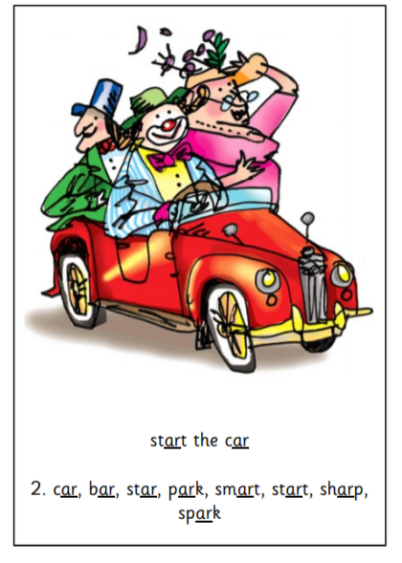

Slide 28


Slide 29
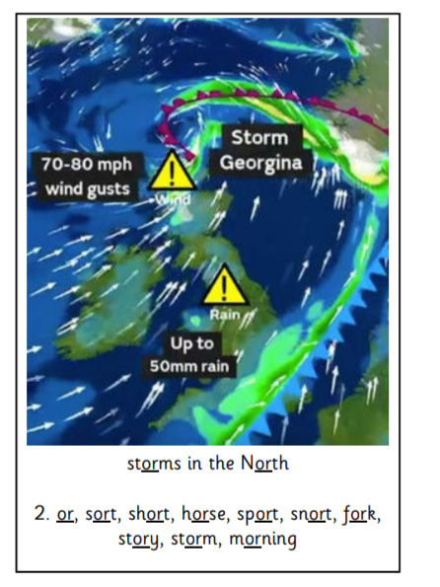

Slide 30


Slide 31
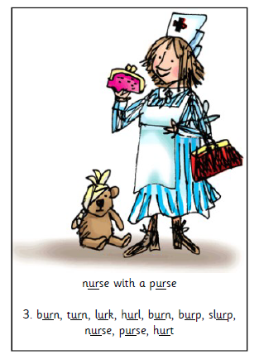

Slide 32


Slide 33
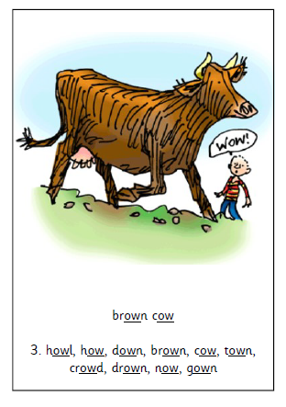

Slide 35
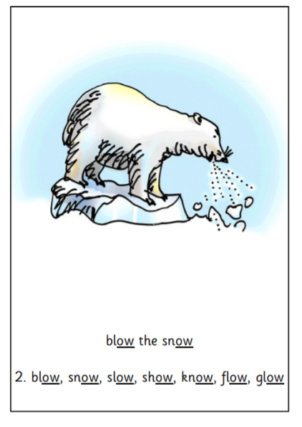

Slide 36
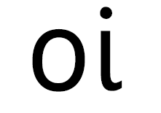

Slide 37
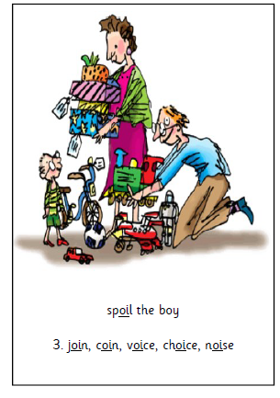

Slide 38


Slide 39
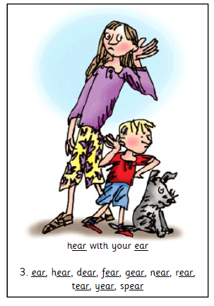

Slide 40


Slide 41
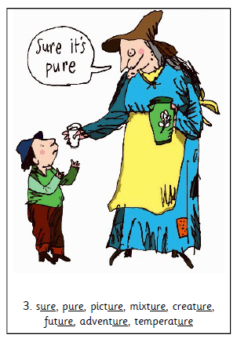

Slide 42


Slide 43
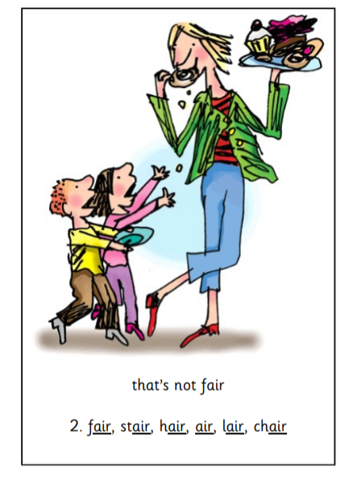

Slide 44


Slide 45


